Slide 1
Chapter 1 – Matplotlib
DATA SWAT
Data Camp - Intermediate Python for Data Science
January 16, 2017
Aryn Moore

Slide 2
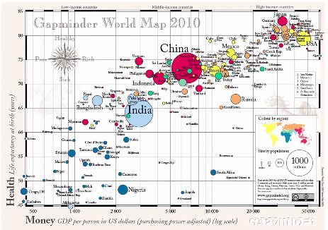
Goal

Slide 3
Goal
Bubble chart
Each bubble represents a country
Size represents country population
X-axis: GDP per capita (US $)
Y-axis: Life expectancy

Slide 4
Basics
Matplotlib is one of many Python visualization packages
Subpackage: pyplot
In [1]: import matplotib.pyplot as plt
Line chart: plt.plot(list1, list2)
List 1 is x axis
List 2 is y axis
plt.show()
Scatter plot: plt.scatter(list1, list2)

Slide 5
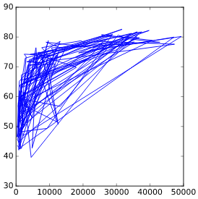
Best way to plot
life_exp: life expectancy for each country and
gdp_cap: GDP per capita per country in US dollars
plt.plot(gdp_cap,life_exp)
plotplt.show()

Slide 6
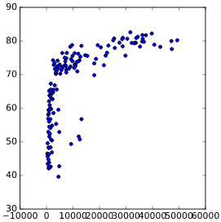
plt.scatter(gdp_cap,life_exp)
plotplt.show()

Slide 7
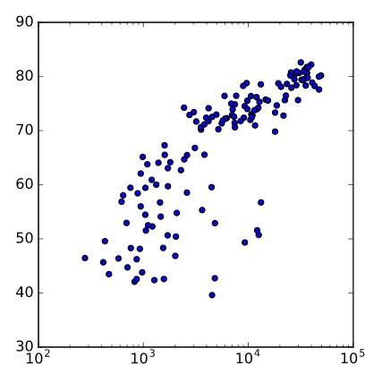
Understand your data!
plt.xscale('log')
plt.show()
Positive correlation between GDP per capita and life expectancy

Slide 8
Histograms
plt.hist(listname, bins = __)
Bins: the marks on the x-axis
X should be a list of values you want to build the histogram for
Designate number of bins using ‘bins = ‘
Python defaults to 10 bins
Based on the number of bins designated, Python will determine the proper bin boundaries

Slide 9
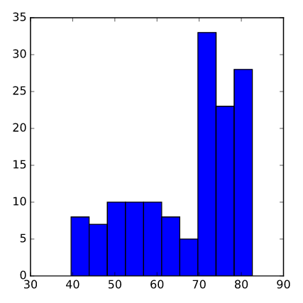
Distribution of life expectancy in different countries
plt.hist(life_exp)
plt.show()
Note: plt.clf()
clears the plot

Slide 10
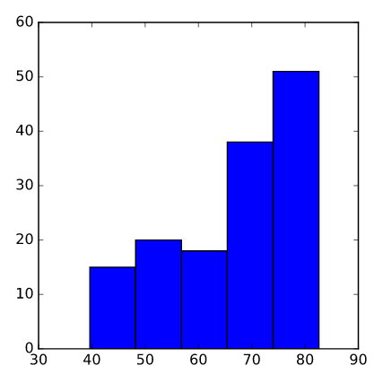
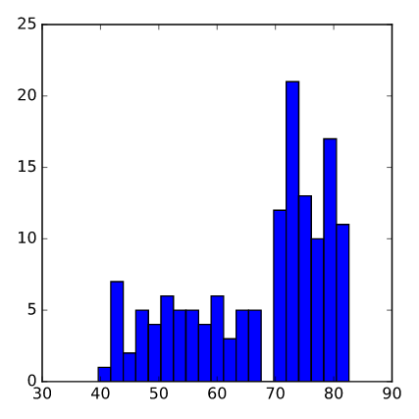
Change in bins
Sljfsd
plt.hist(life_exp, bins = 5) plt.show() | plt.hist(life_exp, bins = 20) plt.show()

Slide 11
Plot Customization: So many options!
Colors
Shapes
Red dashes: r--
Blue squares: bs
Green triagles: g^
Labels
plt.xlabel(‘Label’)
plt.ylabel(‘Label’)
plt.yticks([tick values], [displayed tick labels]
Axes
plt.axis(min_x, max_x, min_y, max_y)
Title
plt.title(‘Title’)

Slide 12
Basic Plot
plt.scatter(gdp_cap, life_exp)
plt.xscale('log')
plt.show()

Slide 13
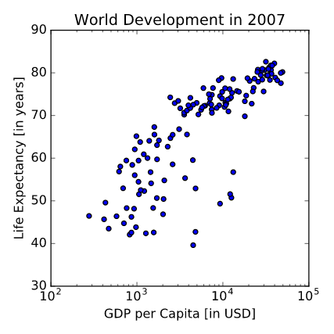
Customize!
plt.xlabel(‘GDP per Capita [in USD]’)
plt.ylabel(‘Life Expectancy [in years]’)
plt.title(‘World Development in 2007’)

Slide 14
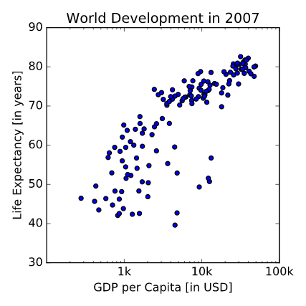
X-tick labels
plt.xticks([1000,10000,100000],['1k','10k','100k'])

Slide 15
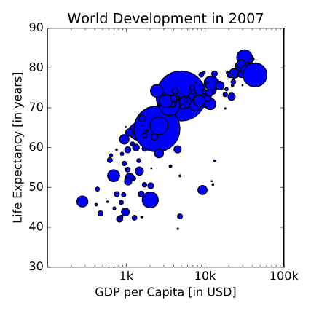
Plot point sizes
List pop contains population numbers for each country expressed in millions
Numpy array
Mult by 2
Set as plot point size
plt.scatter(gdp_cap, life_exp, s = np_pop)

Slide 16
Color, opacity
scatter(x, y, s=20, c=None, marker='o', cmap=None, norm=None, vmin=None, vmax=None, alpha=None, linewidths=None, verts=None, edgecolors=None, hold=None, data=None, **kwargs)
c = color
alpha = opacity
col = ['red', 'green', 'blue', 'blue', … 'red', 'red', 'blue', 'blue']
list with a color for each corresponding country, depending on the continent the country is part of.
continent = list of continent each country belongs to.
A dictionary maps continents onto colors:
dict = { 'Asia':'red', 'Europe':'green', 'Africa':'blue', 'Americas':'yellow', 'Oceania':'black' }

Slide 17
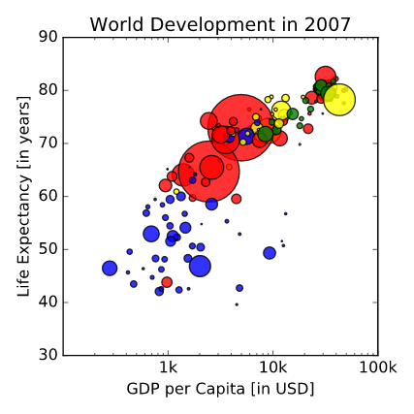
Point color, opacity
plt.scatter(x = gdp_cap, y = life_exp, s = np.array(pop) * 2, c = col, alpha=0.8)

Slide 18

Labels
plt.text(1550, 71, 'India')
plt.text(5700, 80, 'China')
plt.grid(True)

Slide 19
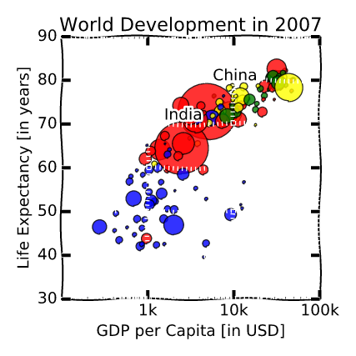
xkcd!
plt.xkcd()
Only affects the plot bits called after the function

Slide 20

(xkcd Refresher)
http://xkcd.com/1335/

